Slide 1
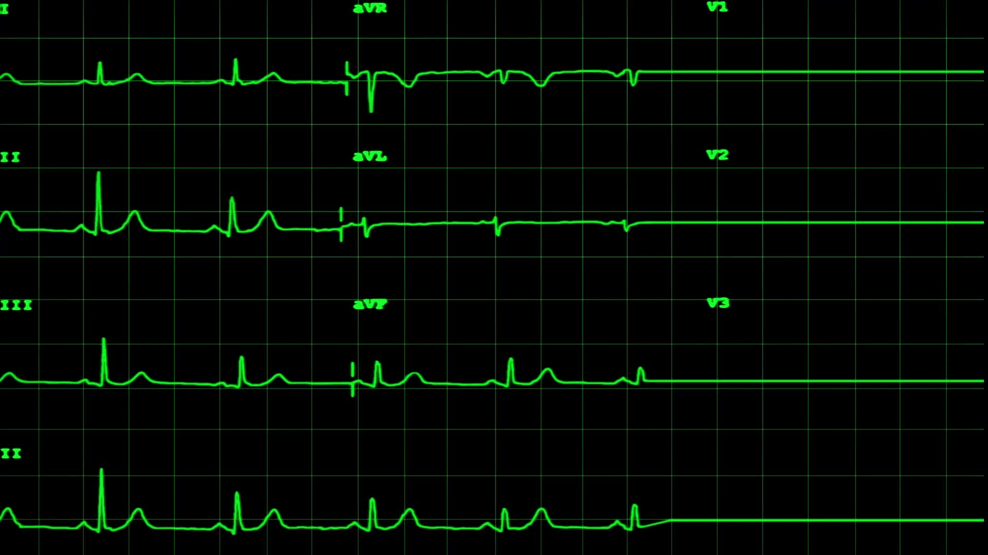
Phenogrouping patients with atrial fibrillation undergoing catheter ablation
Omar Eweis

Slide 2

Introduction – Background
Catheter ablation is a minimally invasive surgical procedure with a goal of treating a multitude of arythmic heart conditions
Catheters are inserted into the groin , going through the veins to the heart
This is followed my a mapping procedure of the heart electrical signals
Then heat or cryo ablation of the tissue producing the irregular heart rhythm
Process boasts high success rate of 85% especially after a second procedure
However, ablation for people with persistent arthymia has shown a success rate of only 50% on average
Notes:
Improvements increase the success rate as catheter sesnors have been improved , heat issues have been managed , saline cooling introduced , heat monitoring also introduced

Slide 3
Catheter ablation - Limitation
Stepwise pre procedure to identify issue could include ct scans, recurring visits , ECGs
Difficult to identify exactly what the issue is from current non-invasive methods
This leads to increased amount of time required during the procedure as diagnosis occurs within the procedure
Increased time during procedure comes with increased risk , another attempt may be required

Slide 4
Future solutions
Improved method attempt to use ECG to reconstruct electrical rhtyms intracardiac drivers that may cause afib before the procedure
Method identifying these drivers have shown similar results to the current step wise approach
In addition, the ablation procedural time can be cut down to 28 minutes rather than 65 minutes
Shorter time and less pre procedure shows promise in reducing cost for catheter ablation and risk during the procedure
Shah, A., Lim, H.S., Yamashita, S., Zellerhoff, S., Berte, B., Mahida, S., Hooks, D.A., Al-Jefairi, N., Derval, N., Denis, A., Sacher, F., Jaïs, P., Dubois, R., Mélèze Hocini and Haïssaguerre, M. (2014). Non Invasive ECG Mapping To Guide Catheter Ablation. [online] 7(3), pp.1139–1139. doi:https://doi.org/10.4022/jafib.1139.
‌
Notes:
Shah, A., Lim, H.S., Yamashita, S., Zellerhoff, S., Berte, B., Mahida, S., Hooks, D.A., Al-Jefairi, N., Derval, N., Denis, A., Sacher, F., Jaïs, P., Dubois, R., Mélèze Hocini and Haïssaguerre, M. (2014). Non Invasive ECG Mapping To Guide Catheter Ablation. [online] 7(3), pp.1139–1139. doi:https://doi.org/10.4022/jafib.1139.
‌

Slide 5
Aim – the prevailing idea
Recreating intracardiac rhythm : Using deep learning methods to recreate intracardiac rhythm so we can evaluate the viability of this method as a non-invasive technique to improve ablation procedure
Use feature selection to develop phenogroups: To create clusters of individuals and identify key characteristics of these clusters to help direct ablation treatment

Slide 6
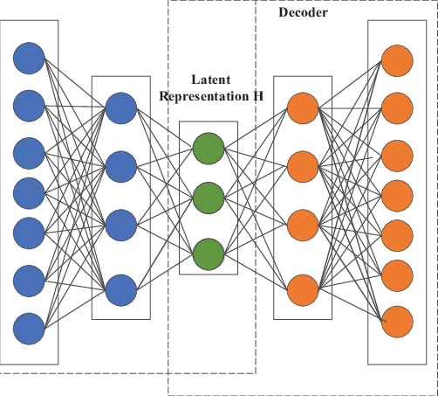
Autoencoder
Encoder (blue) : breaks donw data into a lower dimensional space , to identify the most important patterns
Decoder learns to reconstruct data from the lowest dimension
Here we use this for data reconstruction by attempting to reconstruct the intracardiac rhythm from ecg

Slide 7
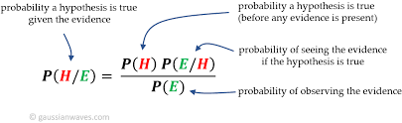
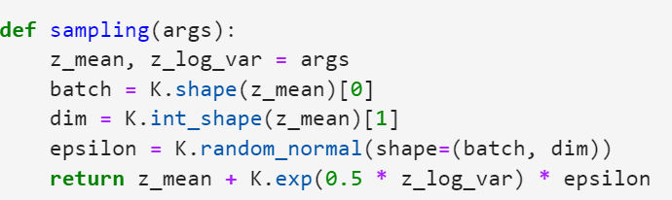
Variational autoencoder
Become popular as generative ai has come to the forefront
Takes a Bayesian approach to the latent space , by assuming a gaussian distribution a priori
Able to sample from the Bayesian distribution instead of the frequentist probabilities to generate slightly new datsets
Improves performance over normal autoencoder , dealing with noisy or missing data
Apply sampling function to auto encoder to help do this

Slide 8
Using variable autoencoder as a solution / further work , limitation
Made and Variational autoencoder that reconstructs intracardiac rhythm
Effective in reconstruction ineffective in predicting patterns using current data
People with persistent afib may just have rhythms that are too unique
Focus on improving predictive ability of the model moving forward
Optimise on ELBO rather than mae loss
Look at ways to actually utilise the laten sampling methods

